Slide 1
Matrix Calculator
Jonas Frankemölle, V. Corina, Luke Genna, Zach Boone

Slide 2
Purpose
User is able to:
Perform basic operations (addition, subtraction, etc.)
Perform matrix operations (addition, subtraction, etc.)
Calculate determinant, dot product, cross product, transpose a Matrix
GUI shows results
Intended for people in need of a matrix based calculator

Slide 3



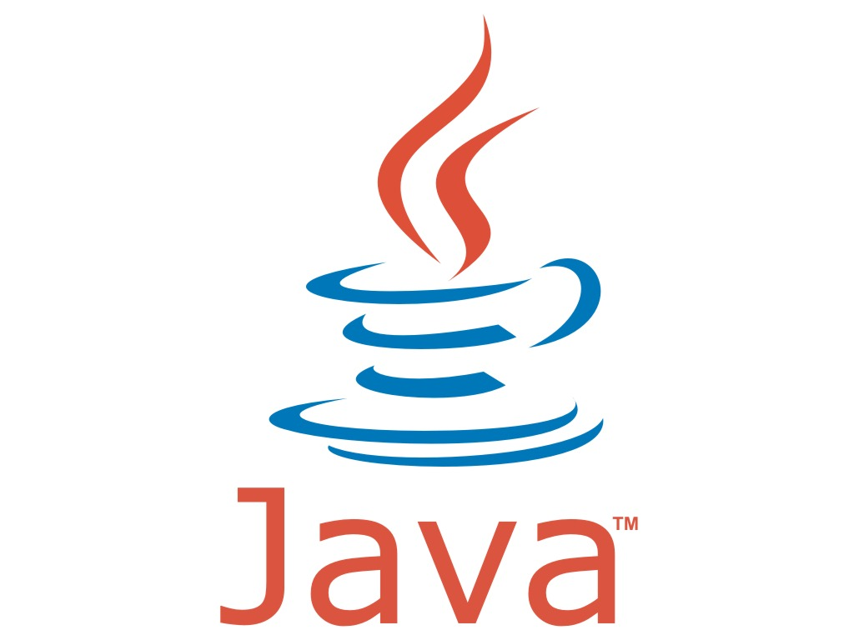

Technologies Used
Java
JUnit
GitHub
NetBeans
Eclipse

Slide 4
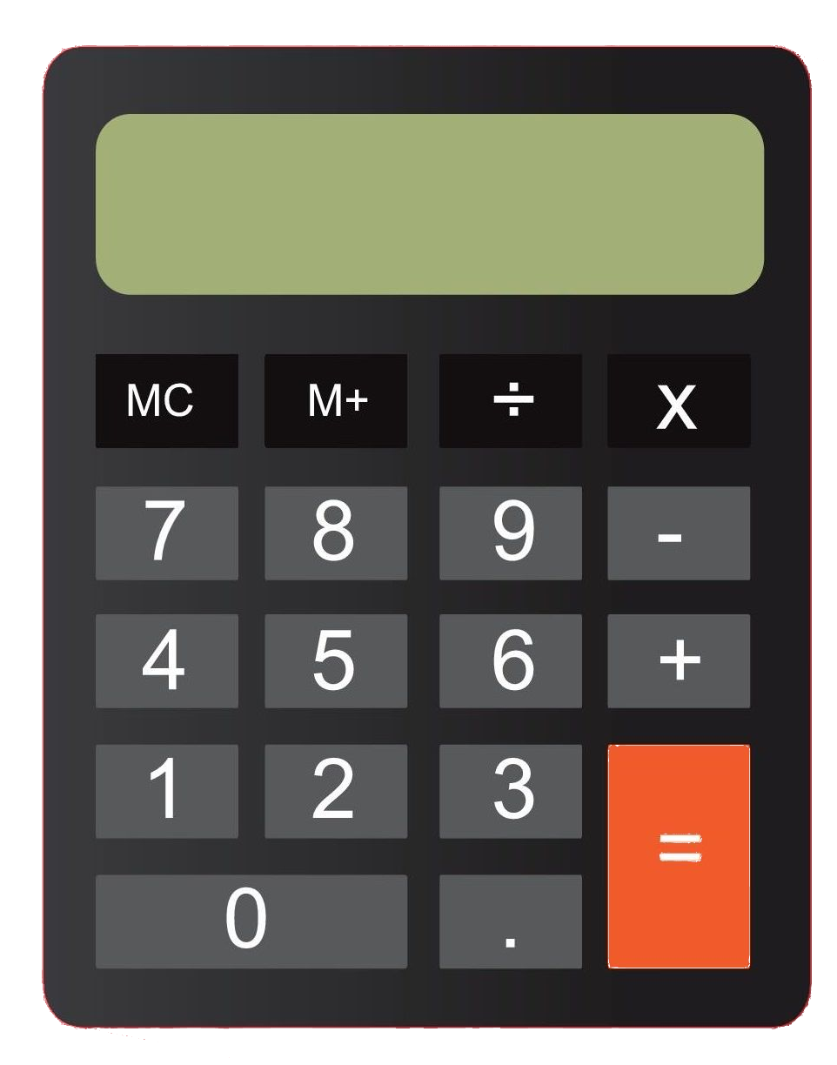
Demonstration
The demonstration station.

Slide 5
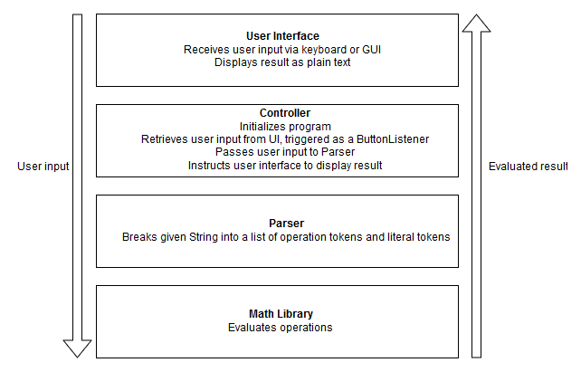
System Overview
Four subsystems
UI
Controller
Parser
Math library
Data flow

Slide 6
Parser
The parser uses a regular expression to split the input into an array of strings. It then converts those strings into literal and operator tokens.
As operations are created, they're added to a priority queue data structure where an operation's priority is its place in the order of operations (PEMDAS) modified by any parenthesis. All operations are then executed in order of priority. When an operation is performed, it inserts the result into the chain of Tokens.
By the end of the execution, all operations have been evaluated and there is a single literal remaining.

Slide 7
Math Functions
Matrix math (add, subtract, multiply, transpose, power, …)
Dot product (Vector Based)
Cross product (Vector Based)
PEMDAS calculations

Slide 8
View
Java Based GUI developed with Swing
Creates a Calculator on your screen
Uses multiple listeners to interpret user input
Input can come from either the user’s keyboard or from the buttons provided
Output is displayed along the expression the user provided

Slide 9
Challenge: Integration
While we were able to communicate and make design choices as a group, development was independent to a fault. For much of development subsystems were written separately and we faced the challenge of integration with deadlines looming.
If we were to do it again, we would be better off designing an agreed upon interface to create seams where subsystems met, as well as performing continuous integration.

Slide 10
Potential Improvements
More graceful error handling
More operations, like determinants and inversion
More abstraction of the classes
More thorough testing
More diverse data types

Slide 11
Questions?
???

